Slide 1
Code obfuscating

Slide 2
Java vs other languages
Java programming language has an important feature, that distinguishes it from other programming languages: while C or C++ directly compiles to a low-level architecture-specific language, Java compiles to a more general and portable format: bytecode.
Although this represents a huge advantage in matter of portability, it could also represent a very important security flaw: a Java executable (jar) is just an archive, which contains a set of .class files containing bytecode.
Anyone could just download one of the thousand Java decompilers available on the Web, feed them with some bytecode, and retrieve (almost) the same originating source code.

Slide 3
So: what to do?
The first thought that comes to mind is, essentially, bytecode encryption. Although this seems a right approach, many dis-advantages are hiding behind the shiny encryption word: the JVM only understands plain bytecode, so we have to decrypt our .class files before injecting them into JVM (but, at that point, decrypted class files are very easy to intercept).
Moreover, if we’re going to decrypt an encrypted bytecode we also need a decryption key, and we must face the ever-lasting problem of key distribution and management.
But what if we build our own JVM? OpenJDK permits this, but it has been shown in [1] that OpenJDK can be easily modified to overcome any bytecode encryption.

Slide 4
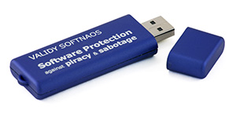
Encryption, again
Although the many disadvantages of using bytecode encryption, some related solutions could still be considered (taken the proper considerations).
One of these solutions is provided by Validy Net Inc.
They developed the so-called Validy SoftNaos [2], that seems a simple USB drive, but actually contains a slave co-processor that receives flows of encrypted instructions from the running application: they interact with a subset of the application state (also stored in the token), subtracting a part of the application to run it inside the token.
This kind of solution lets you hide a small but sensitive part of your application from unwanted attention, handling decryption directly inside the token.
Anyway, it comes with a price: in fact, a strong consideration must be made about performance issues related to the execution of selected Java code (translated to a specific instruction set) on a USB token that has to decrypt the code, relocate necessary data on his address space, and execute it (given his limited computational capabilities). So, tipically, the problem consists in defining the trade-off between the needed protection and the acceptable performance loss.

Slide 5
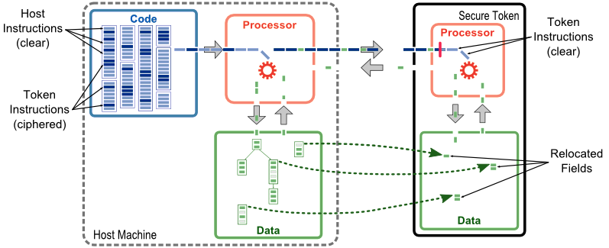
Host instructions are selected and translated to the token instruction set
Selected Fields or variables are relocated to the secure token (although host keeps pointers to locations in token)
At runtime, ciphered instructions and values are forwarded to the token, where they are deciphered, checked for correctness/integrity, and executed

Slide 6
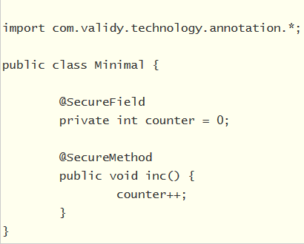
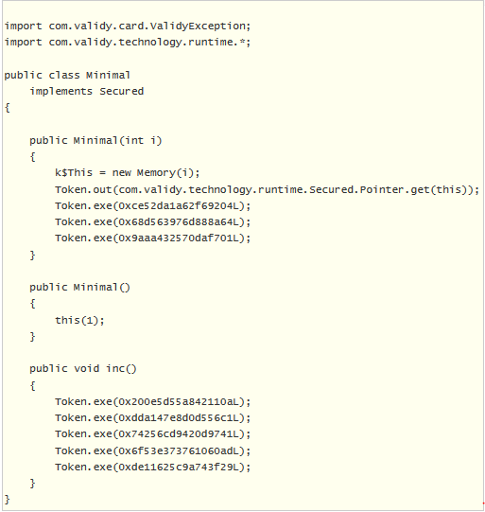
Validy SoftNaos in action
On the left, we have a sample application in which we specified (with Annotations) variables and method that needs to be secured
After standard Java compilation phase, the resulting bytecode is given to the SoftNaos Post-Processor, that translates the code of secure methods into the token instruction set, encrypts the result, and replaces the body of secure methods with sequence of calls transmitting the encrypted instructions to the token for execution. On the right, we have the decompiled bytecode from the post-processed class files.

Slide 7
Moving on..
Seen that bytecode encryption is not always a good idea (and when it is, it’s probably very expensive and complex to realize) we can move towards other approaches.
The basic idea is that, instead of trying to encrypt bytecode, we can try to obfuscate it, making the bytecode less readable.
The main goal of obfuscation is changing the code so that it produces the same results when run, but it is much more harder to understand and analyze when decompiled.
Of course, we are not talking of ‘real’ security: security by obscuring can just make the life of an attacker harder, but it will not completely stop a malicious individual to obtain the informations he wants; so it must be considered just as an additional layer of security, but not the only one.

Slide 8
Name Obfuscation
Name obfuscation is the process of replacing standard naming identifiers (such as com.mycompany.security.checkPermission()) with meaningless sequences of characters, like a.a0().
An interesting side effect of name obfuscation is the reduction of the class file size.
Limitations:
Standard Java API Classes names cannot be obfuscated
Serializable Classes cannot be obfuscated

Slide 9
String Encryption
String encryption is another feature commonly found in Java obfuscators. Replacing string literals with calls to a method that decrypts its parameter makes a hacker's life more interesting, but, unfortunately, not very much.
The main problem is that those encrypted strings need to be decrypted at runtime, so the respective code must be included in the application.
There are also more secure approaches like Stringer [4], which encrypts using encryption keys scattered across the obfuscated code.

Slide 10
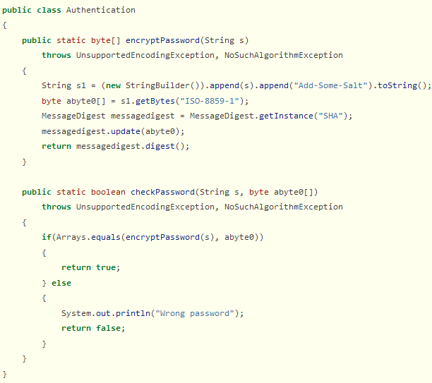
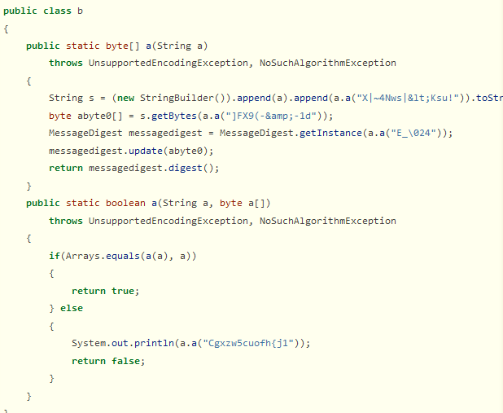
Name Obfuscation and String Encryption in action
On the left the original code, on the right the bytecode decompilation results after applying name obfuscation and string encryption on the original bytecode.

Slide 11
Code Flow Obfuscation
Code Flow Obfuscation deals with modifying a program so that it yields the same results when run, but is harder to decompile it into a structured form.
Most obfuscators replace standard Java instructions with goto, in such a way that a decompiler cannot revert back the process (although not all decompilers are so easily defeated).
Advanced Code Flow Obfuscation techniques include class hierarchy renaming, method inlining and outlining, loop unrolling, etc.
Limitations:
Over obfuscated bytecode may not pass JVM bytecode verification
Code Flow Obfuscation has a negative impact on performance (for example, the previously mentioned Stringer has an impact on performance of about 10 % loss, as the official documentation reports)
Field Failure Data Analysis (FFDA) becomes more difficult (e.g: logging or stack traces)

Slide 12
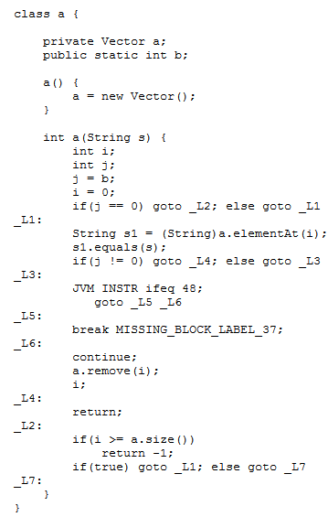
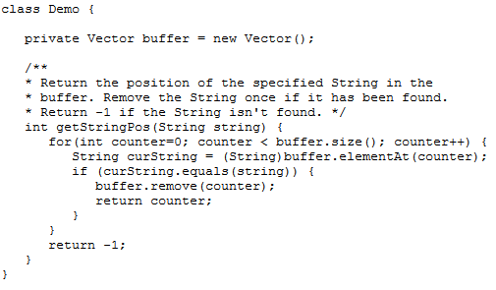
Code Flow and Name Obfuscation in action
On the left there’s the original code, on the right we first applied name and code flow obfuscation on the original bytecode, than tried the decompilation with the shown result (using Zelix Klassmaster examples, [3]).

Slide 13
Example and Applications
We tested a simple Java obfuscator: Jshrink [5].
Jshrink is a Java obfuscator that extracts the minimal set of class files for an application, removes unused code and data, obfuscates symbolic names, finalizes code for optimized execution, and stores the results in a Java jar file.

Slide 14
Final Considerations
Protecting Java bytecode is a very hard task, especially when this code is intended to be delivered outside our production environment.
Although bytecode encryption may seem feasible, it comes with a strong layer of costs, complexity and implementation issues (as Validy SoftNaos shown).
Bytecode obfuscation represents an alternative that could make the attacker’s life harder, but does not provide a complete and assured protection alone (especially when moving towards open-source tools).
However, several professional (and highly paid) services offer concrete solutions for this concern (Stringer, Proguard, Zelix Klassmaster).

Slide 15
References
[1] Overcome OpenJDK Bytecode encryption https://dzone.com/articles/gun-great-equalizer-openjdk
[2] Validy SoftNaos https://www.validy.com/en/technology.html https://www.excelsior-usa.com/blog/excelsior-jet/java-bytecode-encryption-revisited/
[3] Code Flow Obfuscation in Zelix Klassmaster https://www.zelix.com/klassmaster/featuresFlowObfuscation.html
[4] Stringer https://jfxstore.com/stringer/
[5] Jshrink http://www.e-t.com/jshrink.html

